Slide 1
Finite Difference Modelling of All - Solid - State Lithium - Ion Batteries

Slide 2

Finite Difference forms of the Differential equations used in the electrolyte
Eqn – 1 :
$$\frac{∂a}{∂t}= \frac{2{ D}_{{li}^{+}}{ D}_{n−}}{D_{{li}^{+}} + D_{n−}}\frac{∂^{2}a}{∂y^{2}}+r$$
Taking $\frac{2{ D}_{{li}^{+}}{ D}_{n−}}{D_{{li}^{+}} + D_{n−}}=D_{final} , we get :$
$\frac{a_{j}^{i} − a_{j}^{i−1}}{ⅆt}= D_{final }\frac{a_{j+1}^{i−1}−2 a_{j}^{i−1}+ a_{j−1}^{i−1}}{{(dy)}^{2}}$ + r
Taking $D_{final} \frac{dt}{{(dx)}^{2}}= α_{1}$, we get :
$$a_{j}^{i}=a_{j}^{i−1}+ α_{1}\left(a_{j+1}^{i−1} − {2 a}_{j}^{i−1}+ a_{j−1}^{i−1}\right)+r dt$$
Where,
$$r= k_{d}a_{{li}^{0}}− k_{r}a_{{li}^{+}}a_{n−}$$
Given:
$k_{d }= k_{r} \frac{a_{0}δ^{2}}{1− δ}$ ; $a_{{li}^{+}}= a_{n−}$ = $a(y,t)$ ; $a_{{li}^{0}} = a_{0}− a_{{li}^{+}}$ = ${ a}_{0} − a\left(y,t\right)$

Slide 3

Continued…
Also, a (y , t) = $a_{j}^{i}$, where i represents the time step and j represents the position.
Finally,
$$r = k_{d}a_{0} − k_{d}a − k_{r} a^{2}$$
Substituting this relation, we get :
$$a_{j}^{i}=a_{j}^{i−1}+ α_{1}\left(a_{j+1}^{i−1} − {2 a}_{j}^{i−1}+ a_{j−1}^{i−1}\right) + dt (k_{d}a_{0} − k_{d}a_{j}^{i−1} − k_{r}{a_{j}^{i−1}}^{2})$$
Eqn - 2
$$a\left(y,0\right)= {δa}_{0}$$
Finally,
$$a_{j}^{1}=δa_{0}$$

Slide 4

Continued…
Eqn – 3 :
$$\frac{∂a(0,t)}{∂t}= \frac{I(t)}{2FAD_{{li}^{+}}}$$
Taking I(t) = 60 μA and $β_{1}= \frac{I(t)}{2FAD_{{li}^{+}}} :$
$$\frac{a_{2}^{i} − a_{1}^{i}}{Δy} = β_{1}$$
Therefore,
$$a_{1}^{i} = a_{2}^{i} − β_{1}(Δy)$$

Slide 5

Finite Difference forms of the Differential equations used in the electrode
Eqn – 1 :
$$\frac{∂a_{liCoO_{2}}}{∂t} = D_{li} \frac{∂^{2}a_{liCoO_{2}}}{∂y^{2}}$$
On converting, we get :
$$\frac{a_{j}^{i} − a_{j}^{i−1}}{Δt} = D_{li}\frac{a_{j+1}^{i−1} − 2a_{j}^{i−1}+ a_{j−1}^{i−1}}{{(Δy)}^{2}}$$
Taking, $α_{2}= D_{li} \frac{Δt}{{(Δx)}^{2}}$ :
$$a_{j}^{i}= a_{j}^{i−1} + α_{2} (a_{j+1}^{i−1} −2a_{j}^{i−1}+ a_{j−1}^{i−1})$$

Slide 6

Continued…
Eqn – 2 :
$${a(y,0)}_{liCoO_{2}}= a_{liCoO_{2}}^{0}$$
Finally,
$$a_{i}^{1} = a_{liCoO_{2}}^{0}$$
Eqn - 4 :
$$\frac{∂a_{liCoO_{2}}(L+M,t)}{∂t}=0$$
$$\frac{a_{n}^{i} − a_{n−1}^{i}}{Δy} = 0$$
Therefore,
$$a_{n}^{i} = a_{n−1}^{i}$$

Slide 7
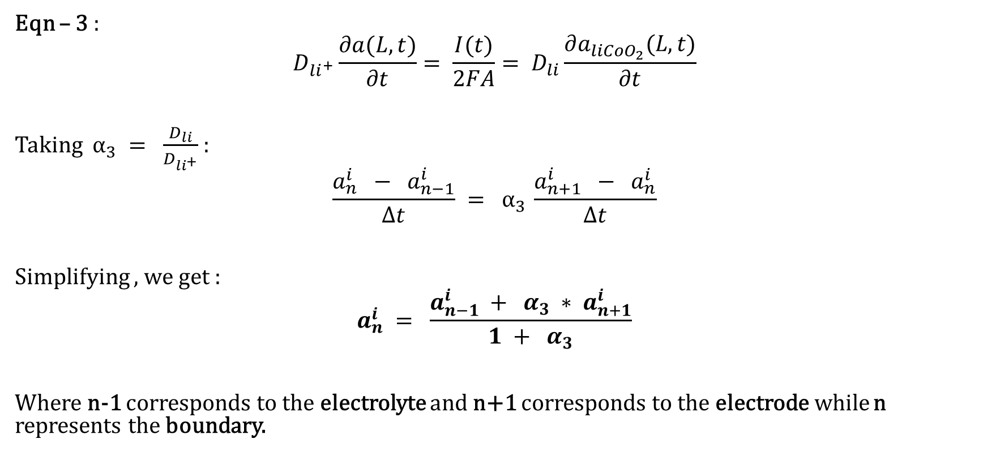
At the common boundary of the electrode and the electrolyte
Eqn – 3 :
$$D_{{li}^{+}}\frac{∂a(L,t)}{∂t}= \frac{I(t)}{2FA}= D_{li}\frac{∂a_{liCoO_{2}}(L,t)}{∂t}$$
Taking $α_{3} = \frac{D_{li}}{D_{{li}^{+}}}$ :
$$\frac{a_{n}^{i} − a_{n−1}^{i}}{Δt} = α_{3 }\frac{a_{n+1}^{i} − a_{n}^{i}}{Δt}$$
Simplifying , we get :
$$a_{n}^{i} = \frac{a_{n−1}^{i} + α_{3} {∗ a}_{n+1}^{i}}{1 + α_{3}}$$
Where n-1 corresponds to the electrolyte and n+1 corresponds to the electrode while n represents the boundary.

Slide 8
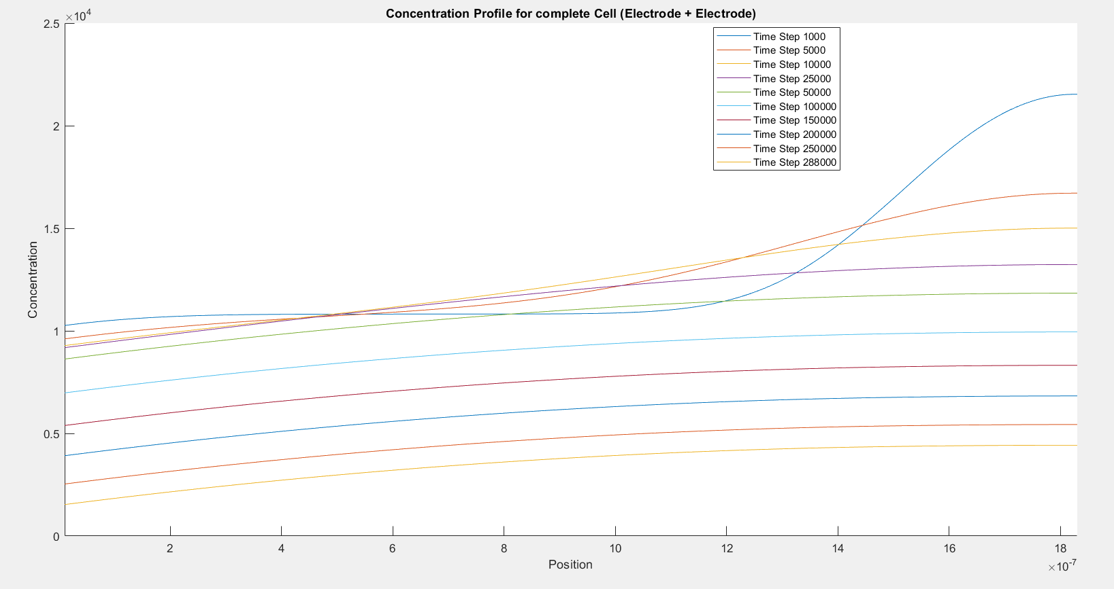

Slide 9
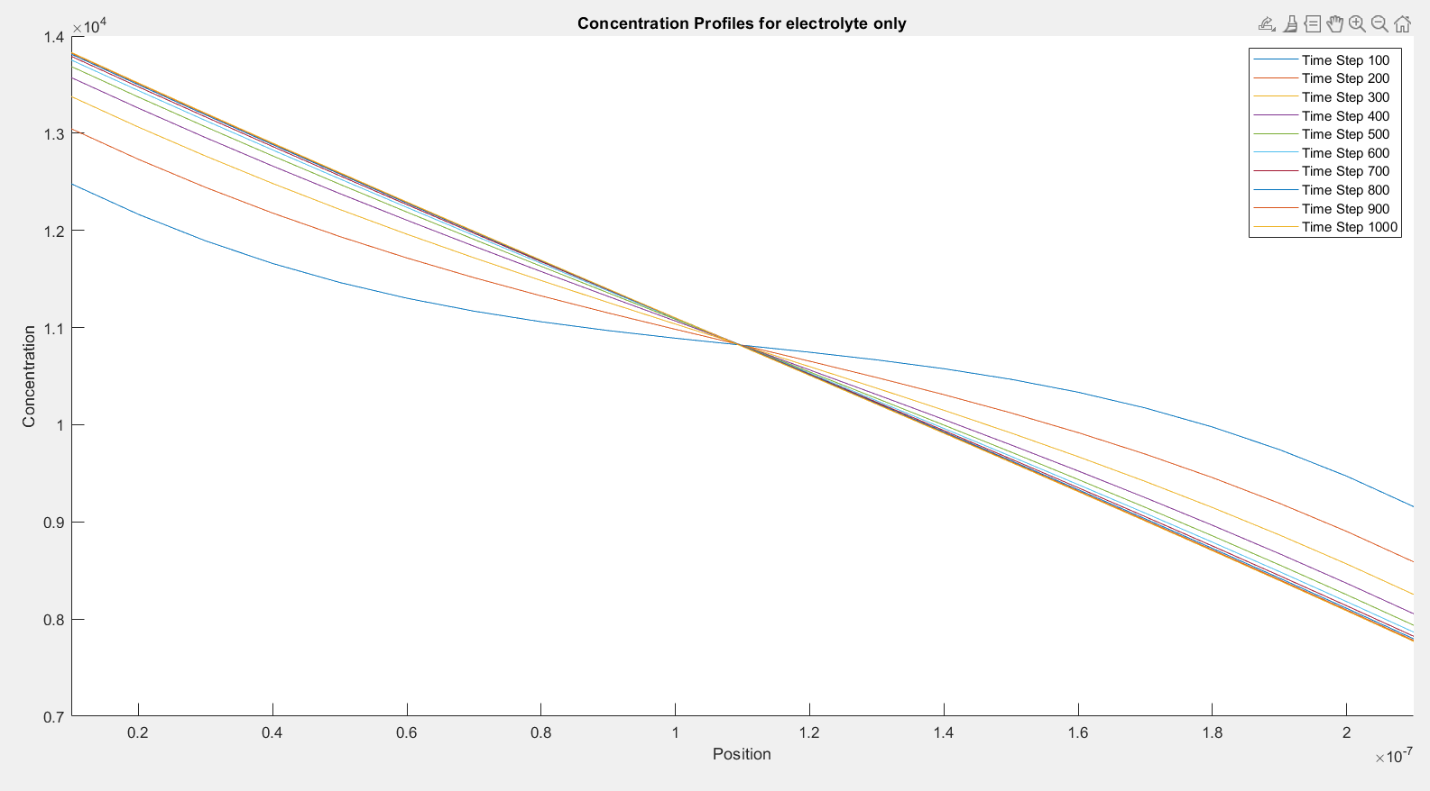

Slide 10
Electrochemical Modeling of the Current-Voltage Characteristics of an SOFC in Fuel Cell and Electrolyzer Operation Modes

Slide 11
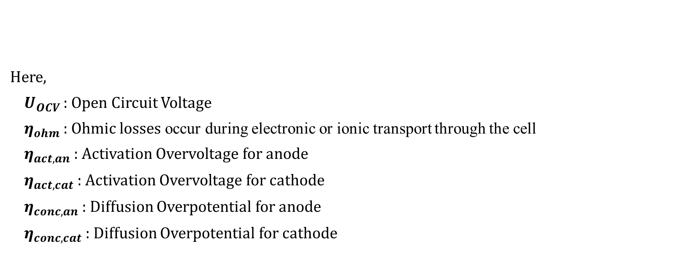
Calculation of the Cell Voltage
Here,
$U_{OCV }:$ Open Circuit Voltage
${ η}_{ohm}$ : Ohmic losses occur during electronic or ionic transport through the cell
${ η}_{act,an}$ : Activation Overvoltage for anode
${ η}_{act,cat}$ : Activation Overvoltage for cathode
${ η}_{conc,an}$ : Diffusion Overpotential for anode
${ η}_{conc,cat}$ : Diffusion Overpotential for cathode

Slide 12



Calculation of the ohmic losses
Where, j represents the current density and $R_{ohm}$ is calculated using the following relation :
Here,
$E_{act,ohm}$ : Activation Energy in kJ/mol
$B_{ohm}$ : Material specific constant
T : Temperature

Slide 13
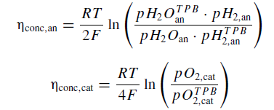
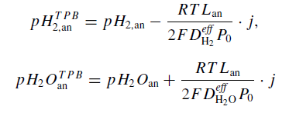
Calculation of the Diffusion Overpotential
Here, $pH_{2,an}$ ; $pH_{2}O_{an}$ ; $pO_{2,cat}$ are known
While, the remaining quantities are to be calculated at the Triple Phase Boundary
These quantities are determined by applying the Fick’s first law :

Slide 14


Continued…
In these three relations the diffusivities used are as follows:
$D_{H_{2}}^{eff}=6.5$× $\frac{{10}^{−5}{ m}^{2}}{s}$
$D_{H_{2}O}^{eff}=3.8$× $\frac{{10}^{−5}{ m}^{2}}{s}$
$D_{O_{2}}^{eff}=1.63$× $\frac{{10}^{−5}{ m}^{2}}{s}$
Also, $p_{tot}=1 atm$

Slide 15



Calculation of the Activation Overvoltage
From this equation we need to find $η_{act,el}$
Taking , $x= \frac{n_{e} F η_{act,el}}{R T}$
$$j=j_{0,el} [\exp\left(xα_{el}\right) − exp⁡(−\left(1 − α_{el}\right)x) ]$$
Again, taking $c= \frac{j}{j_{0,el}}$
$$f\left(x\right)=\exp\left(xα_{el}\right) − \exp\left(−\left(1 − α_{el}\right)x\right) − c$$

Slide 16
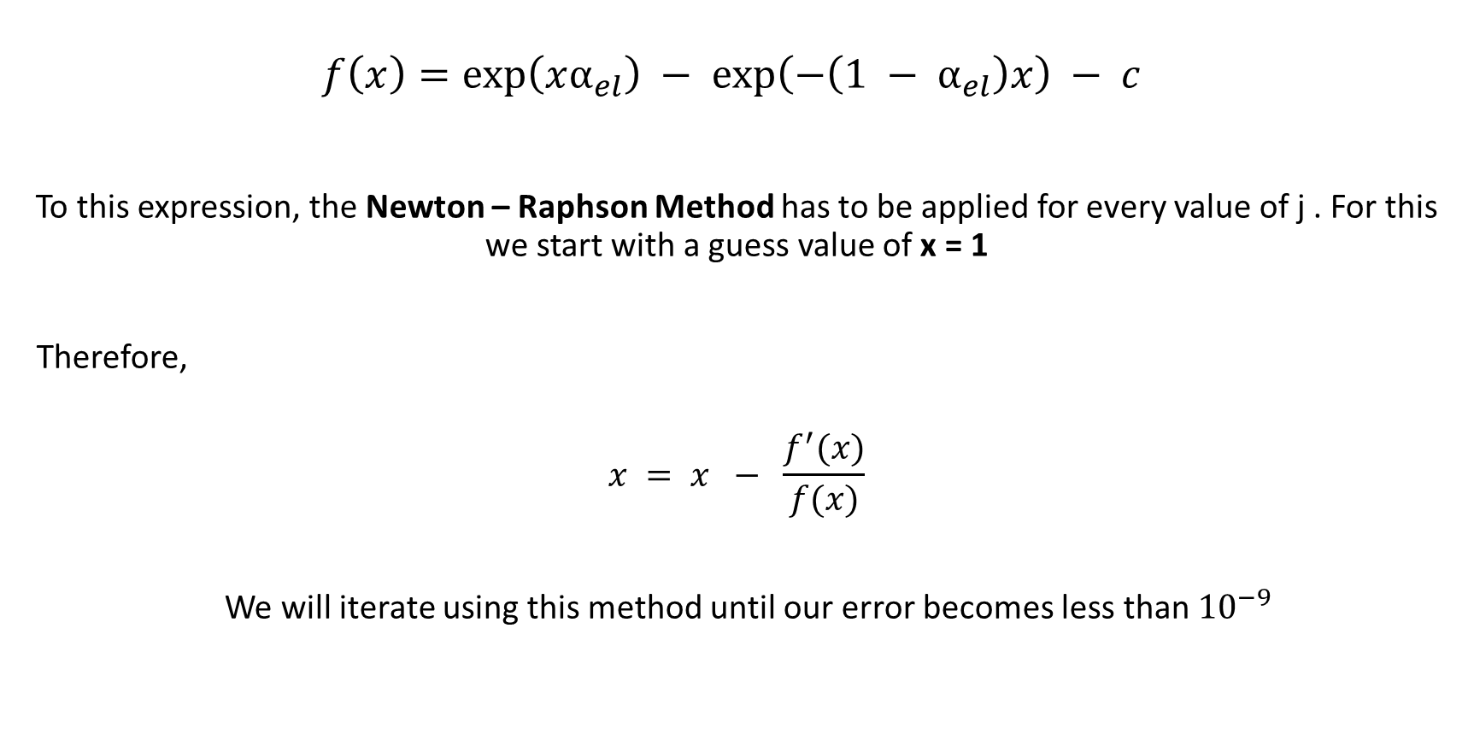
Continued...
$$f\left(x\right)=\exp\left(xα_{el}\right) − \exp\left(−\left(1 − α_{el}\right)x\right) − c$$
To this expression, the Newton – Raphson Method has to be applied for every value of j . For this we start with a guess value of x = 1
Therefore,
$$x = x − \frac{f^{′}(x)}{f(x)}$$
We will iterate using this method until our error becomes less than ${10}^{−9}$

Slide 17
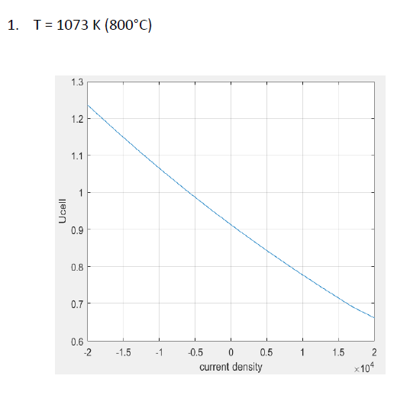
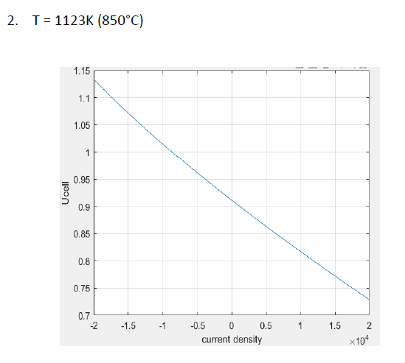

Slide 19
